Slide 1
Caw Caw Canal and Little Caw Caw Canal Floodway Study Results - Presentation
Brunswick Plantation Community Meeting July 15, 2025
James Paggioli, CFM
Floodplain Administrator
James.paggioli@brunswickcountync.gov
910.253.2054

Slide 2
Title of Contents
Section 1 – History and Historic Flood Mapping
Section 2 – Hydrology and Hydraulics Study, Timeline and Results
Section 3 – Effects upon Individual Properties and Resources

Slide 3
Section 1
History and Historic Flood Mapping

Slide 4
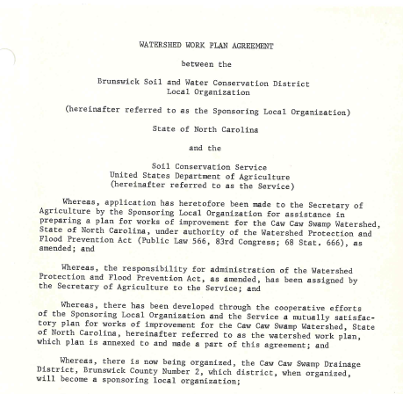
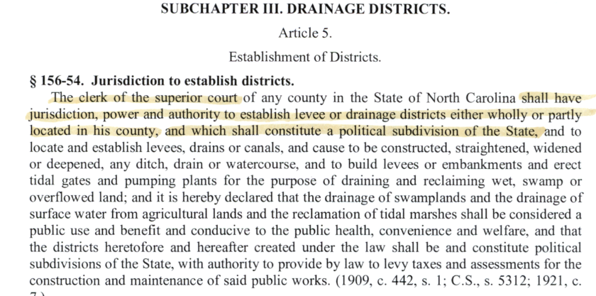
Pre-Brunswick Plantation and Pre-Flood Mapping Events
The North Carolina Legislature Authorizing the Creation of Drainage Districts
The Caw Caw Swamp Drainage District is created circa 1964/1965 and develops Work Plans for the Construction of the Caw Caw And Little Caw Caw Canals
.

Slide 5
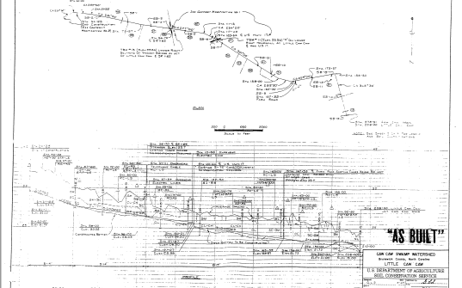
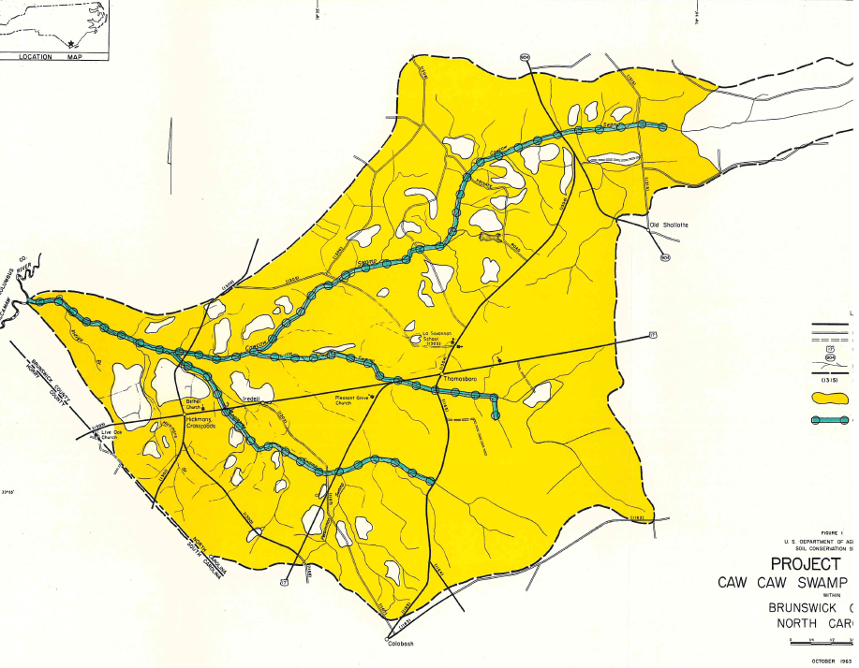
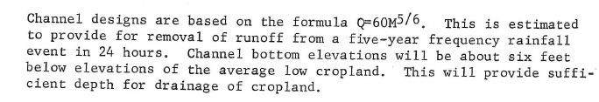
Project Plans and Work Plan Designs Constructed

Slide 6
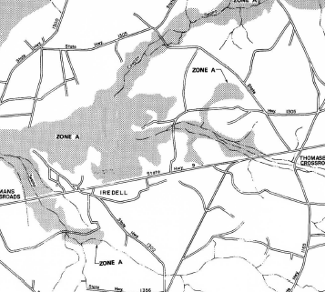
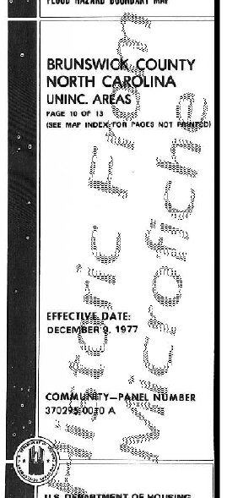
First Flood Hazard Map from FEMA Of Brunswick Plantation Area
Map Date December 9, 1977 Map 370295-0010A
Brunswick
Plantation Area

Slide 7
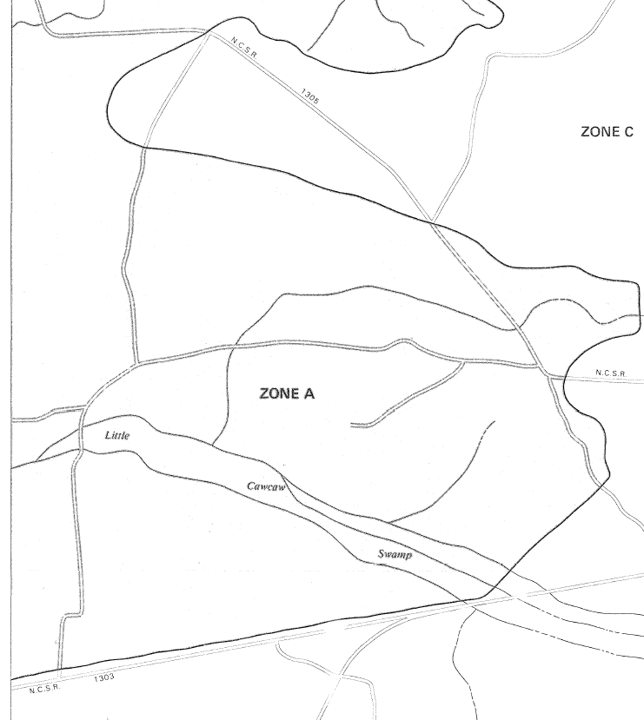
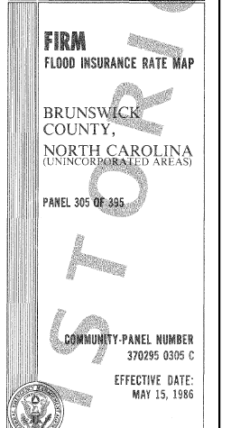
REVISED FIRM Mapping from FEMA Of Brunswick Plantation Area
Map Date May 15, 1986 Map 370295-0305C
Brunswick
Plantation Area

Slide 8
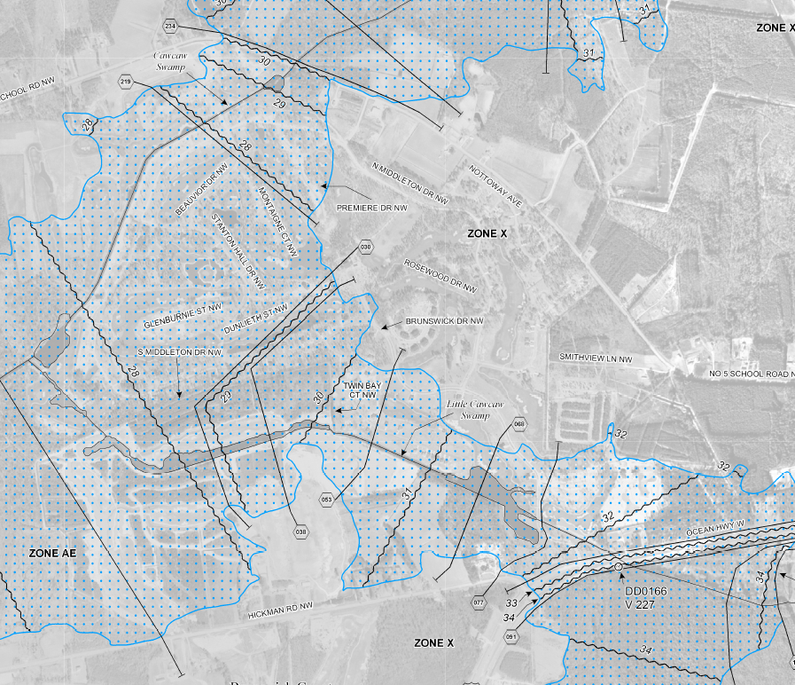
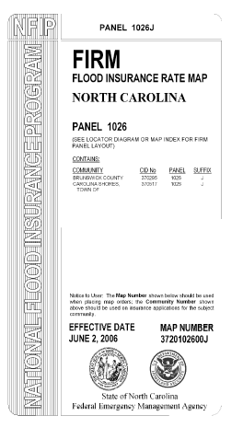
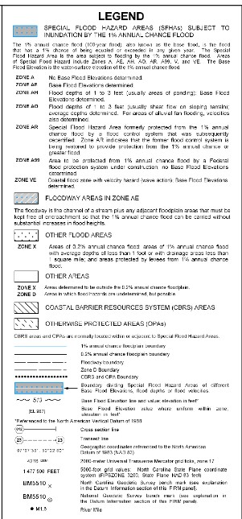
REVISED FIRM Mapping from FEMA Of Brunswick Plantation Area
Map Date June 2, 2006 Map 3720102600J
Brunswick
Plantation Area

Slide 9
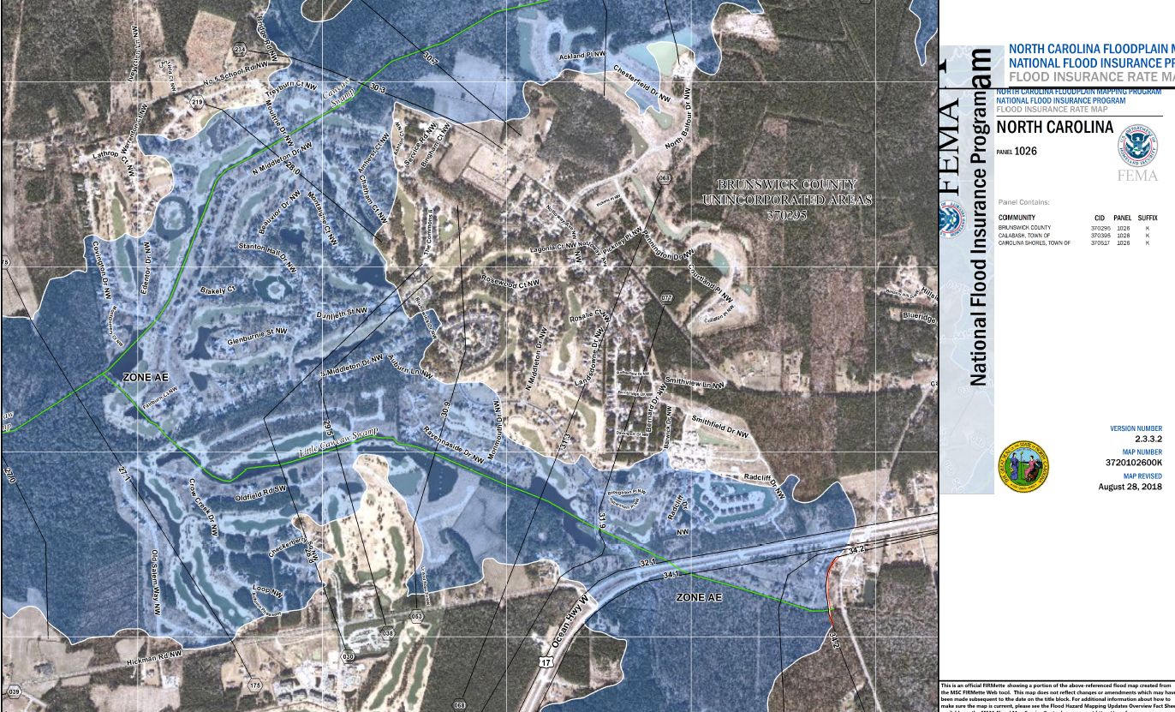
REVISED FIRM Mapping from FEMA Of Brunswick Plantation Area
Map Date August 28, 2018 Map 3720102600K
Brunswick
Plantation Area

Slide 10
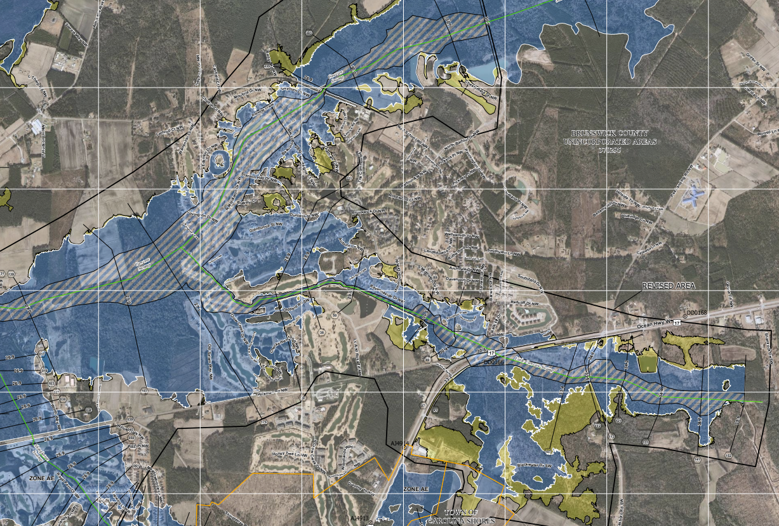
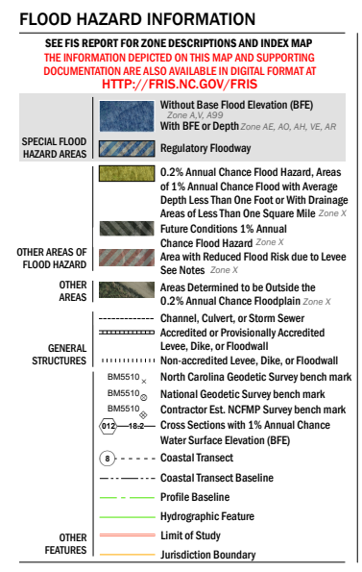
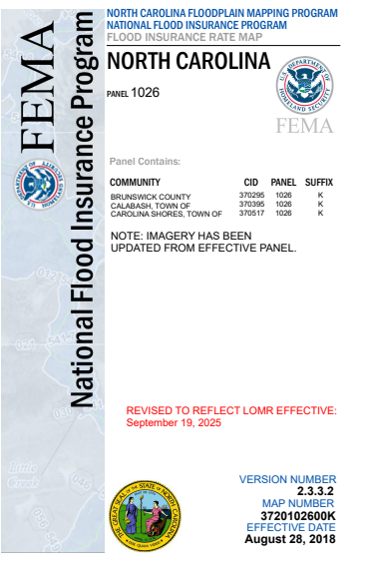
PROPOSED FIRM Mapping PER STUDY/LOMC Of Brunswick Plantation Area
CASE 23-04-1192P -370295
Proposed Effective Date September 19, 2025 Revised Study Area of Map 3720102600K
Brunswick
Plantation Area

Slide 11
Section 2
Hydrology and Hydraulics Study
Time Line and Final Results

Slide 12
Current FEMA / NFIP Definitions
Flood Zone -Flood hazard areas identified on the Flood Insurance Rate Map are identified as a Special Flood Hazard Area (SFHA). SFHA are defined as the area that will be inundated by the flood event having a 1-percent chance of being equaled or exceeded in any given year. The 1-percent annual chance flood is also referred to as the base flood or 100-year flood. SFHAs are labeled as Zone A, Zone AO, Zone AH, Zones A1-A30, Zone AE, Zone A99, Zone AR, Zone AR/AE, Zone AR/AO, Zone AR/A1-A30, Zone AR/A, Zone V, Zone VE, and Zones V1-V30. Moderate flood hazard areas, labeled Zone B or Zone X (shaded) are also shown on the FIRM, and are the areas between the limits of the base flood and the 0.2-percent-annual-chance (or 500-year) flood. The areas of minimal flood hazard, which are the areas outside the SFHA and higher than the elevation of the 0.2-percent-annual-chance flood, are labeled Zone C or Zone X (unshaded).

Slide 13
Definitions: Brunswick County Flood Damage Prevention Ordinance
Non Encroachment Area ”(NEA)" - means the channel of a river or other watercourse, including the area above a bridge or culvert when applicable, and the adjacent land areas that must be reserved in order to discharge the base flood without cumulatively increasing the water surface elevation more than one (1) foot as designated in the Flood Insurance Study report.
Floodway-means the channel of a river or other watercourse, including the area above a bridge or culvert when applicable, and the adjacent land areas that must be reserved in order to discharge the base flood without cumulatively increasing the water surface elevation more than one (1) foot.

Slide 14
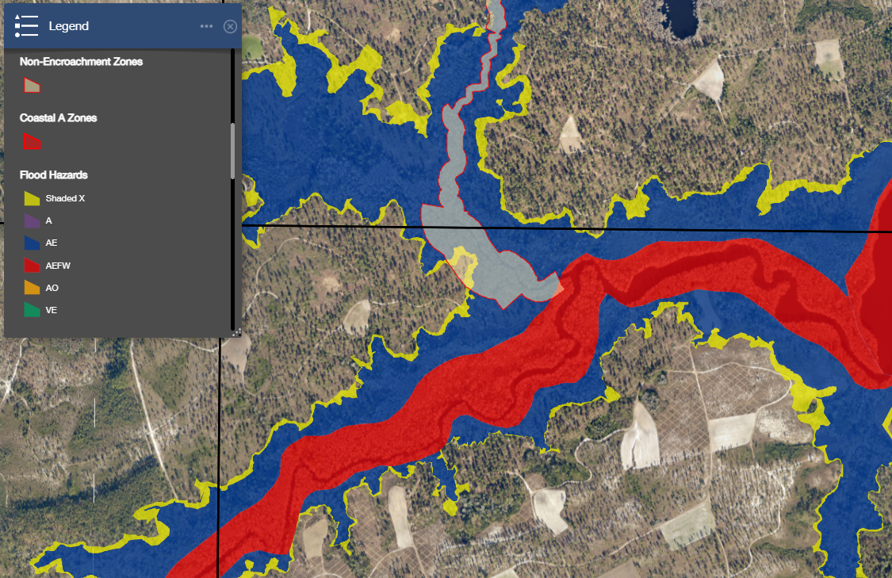
Definitions: Flood Zone, NEA, Floodway, What it looks like on a Map

Slide 15
Definitions: Brunswick County Flood Damage Prevention Ordinance
Can I Build in a Non-Encroachment Area or Floodway…
The answer is Yes, but with the following conditions met along with the other Flood Zone requirements.
Floodways and Non-Encroachment Areas
Areas designated as floodways or non-encroachment areas are located within the Special Flood Hazard Areas established in Article 7.1.3, Section B. …..The following provisions, in addition to standards outlined in Article 7.1.5, Sections A and B, shall apply to all development within such areas:
(1) No encroachments, including fill, new construction, substantial improvements and other developments shall be permitted unless:
(a) It is demonstrated that the proposed encroachment would not result in any increase in the flood levels during the occurrence of the base flood discharge, based on hydrologic and hydraulic analyses performed in accordance with standard engineering practice and presented to the Floodplain Administrator prior to issuance of floodplain development permit; or
(b) A Conditional Letter of Map Revision (CLOMR) has been approved by FEMA. A Letter of Map Revision (LOMR) must also be obtained within six months of completion of the proposed encroachment.

Slide 16
Caw Caw Canal And Little Caw Caw Canal H&H Study
In 2021, Brunswick County contracted with ATM Engineers, (Now GeoSyntec ) to perform Hydrology and Hydraulics Analysis of the Caw Caw Canal, Little Caw Caw Canal systems in the Brunswick Plantation, Crow Creek Development Areas in order to determine if the existing Non-Encroachment Areas established in 2006 were accurate and establish a Floodway for the study area that would represent detailed and current land use, canal hydraulics and updated hydrologic information.
The H&H Study consists of the following basic Tasks:
1) Acquire Detailed Current Canal and Topographic Data of the Study Area
2) Assemble Current Land Use Coverage and Most Up to Date Storm Modeling
3) Calculate the Existing Storm Flow Data through out Study Area contribution Watershed
4) Model and Determine Base Flood Elevations throughout the Study Area utilizing the assembled Cross-Section data.
5) Determine the Floodway area based upon definition and flow paths that are calculated in Task #4.
Modeling and results are then submitted to NCEM NCFlood Mapping Review. Review was conducted by third party Engineering consultant sub-contracted by the State of North Carolina. Review consists of both methodology, data consistency and presentation of results.

Slide 17
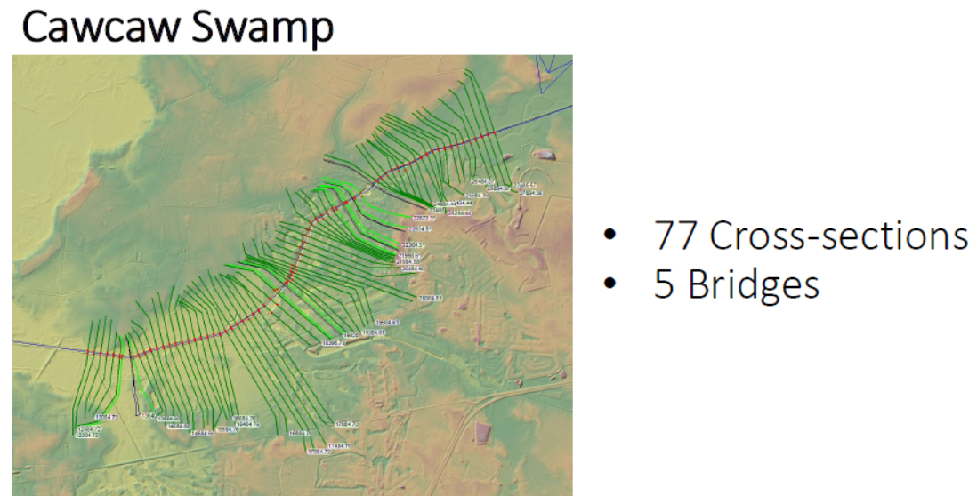
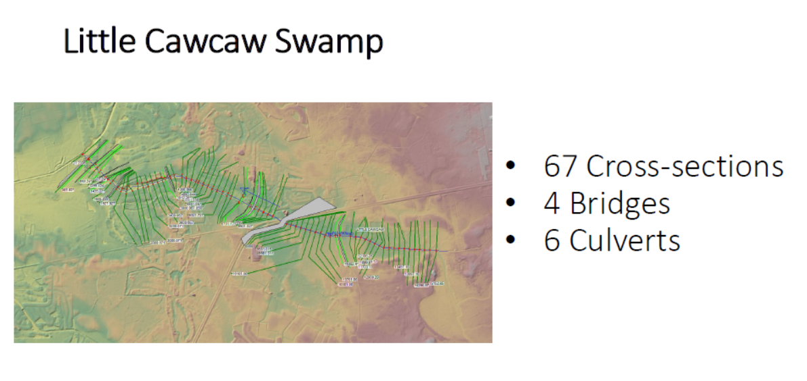
Caw Caw Canal And Little Caw Caw Canal H&H Study
Task 1 – Field Survey and merge with current LIDAR topography 144 Cross-sections, 9 Bridge detail surveys and 6 Culverts

Slide 18
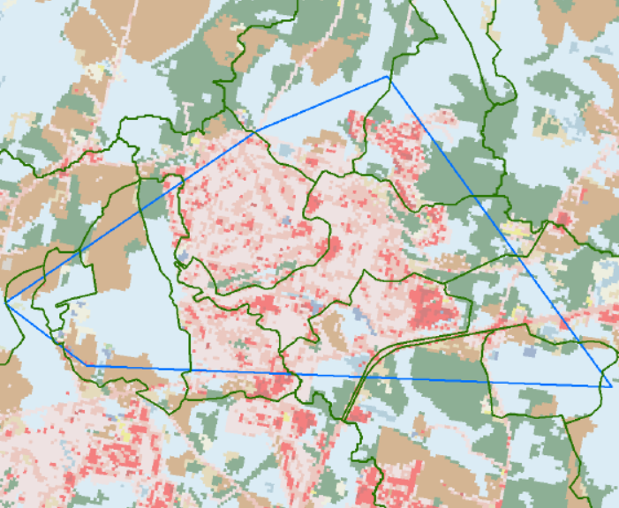
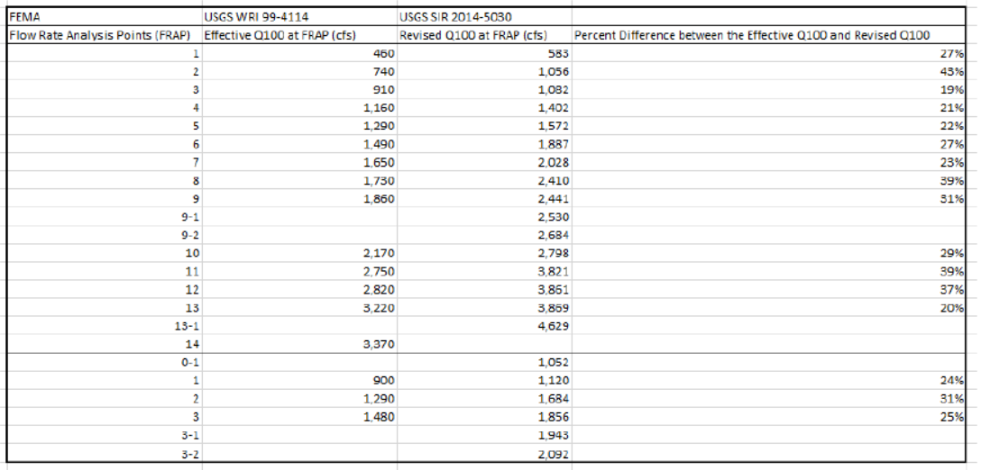
Caw Caw Canal And Little Caw Caw Canal H&H Study
Task 2 – Assemble Current Land Use Coverage and Up to Date Storm Modeling

Slide 19
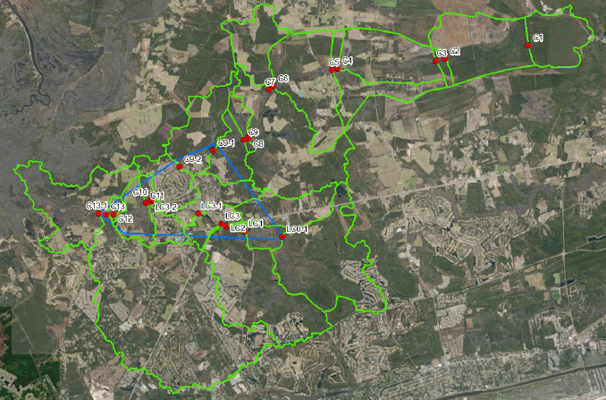
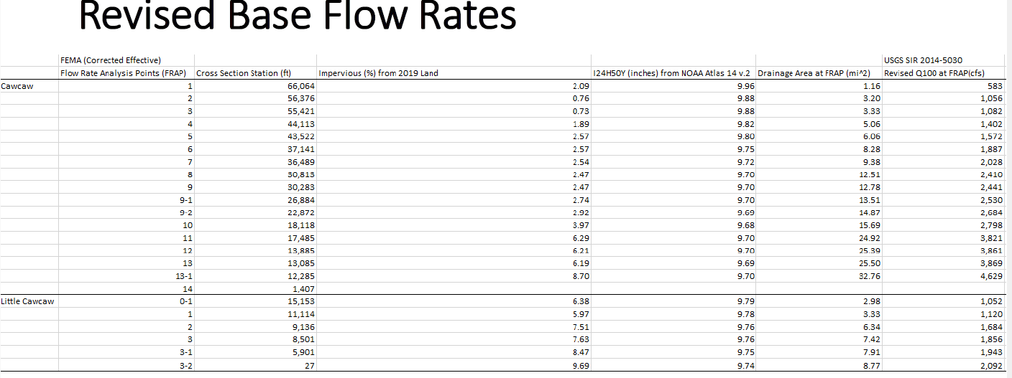
Caw Caw Canal And Little Caw Caw Canal H&H Study
Task 3 – Calculate Existing Storm Flow Data throughout Study Area Watershed

Slide 20
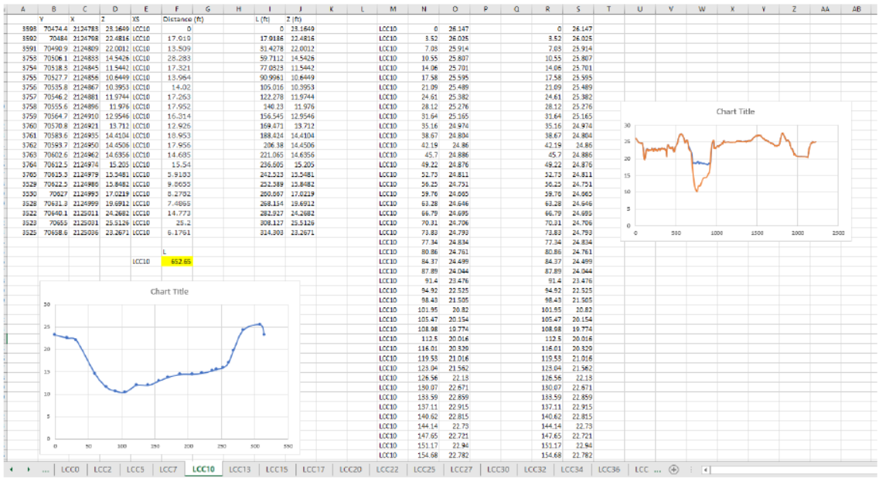
Caw Caw Canal And Little Caw Caw Canal H&H Study
Task 4 - Model and Determine Base Flood Elevations throughout Study Area

Slide 21
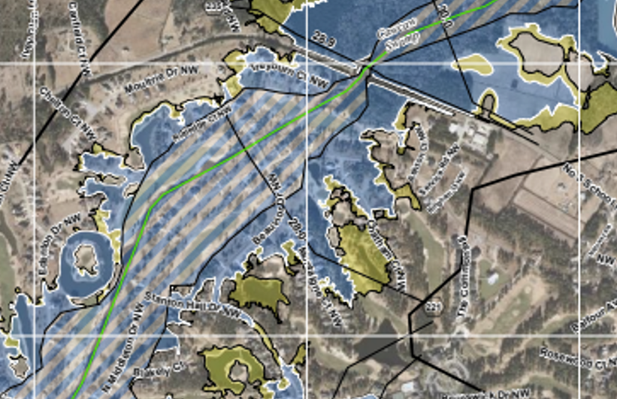
Caw Caw Canal And Little Caw Caw Canal H&H Study
Task 5 – Determine the Floodway Area Based upon Definition and Flow Paths that have been calculated/identified in Task 4 and depict along with Flood Zone Limits.

Slide 22
Caw Caw Canal And Little Caw Caw Canal H&H Study
Timeline of Review Process:
Date of original submittal To NCFlood and Peer Review – December 20, 2022
Review Comments received - March 19, 2023
Date of First revision submittal – June 17, 2023
Review Comments received – September 14, 2023
Date of Second revision submittal – January 24, 2024
Review Comments received – March 11, 2024
Date of Third revision submittal –June 9, 2024
Date of Notice in accordance with C.F.R. requirements - December 30, 2024
Date of Final Determination Letter from FEMA – May 5, 2025
Effective Date for Mapping and Study to become effective - September 19, 2025

Slide 23
Section 3
Effects upon Individual Properties and Resources

Slide 24
Caw Caw Canal And Little Caw Caw Canal H&H Study REsults
Overall Statistics
Non-Encroachment Area to Floodway Data
66 Properties were removed from NEA and are not located in the Floodway
92 Properties were not located within the NEA and will be located within the Floodway
118 Properties had no significant change between NEA and Floodway Status
Flood Zone SFHA 2018 to Study Results
329 Housing Units or properties are removed from AE Flood Zone
95 additional Properties have LOMA or LOMR-F
Reaffirmed
5 Properties were added to SFHA
Newly Created Shaded X Zone

Slide 25
INDIVIDUAL PROPERTIES FAQ’s
My home/property was located with the previous Non-Encroachment Area (NEA), but now my home/property is NOT located in the Floodway. What does this mean for my home/property?
Within the study area, any of the lots/homes removed from the NEA remained within the AE Flood Zone. Any development that would occur with the AE Flood Zone would still be subject to the Flood Damage Prevention Ordinances, however the need to obtain No-Rise Studies for new development work (new homes or additions, etc.) is not required.

Slide 26
INDIVIDUAL PROPERTIES FAQ’s
What does I mean if my home/property is located within the Floodway?
Any homes and structures that have been permitted and/or built and are in existence prior to the effective date of September 19, 2025, would be considered Existing Non-Conforming Structures. This is the same as all homes that were in existence prior to any change of a FEMA Flood Zone or regulation that impacted the home (such as a change in Flood Zone, Base Flood Elevation, or a regulation that goes into effect after a structure has been constructed). No changes to the existing homes are required to be made.

Slide 27
INDIVIDUAL PROPERTIES FAQ’s
Should damage occur to a home within the Floodway, can I rebuild it?
Yes, however, there are different requirements depending on how much damage was sustained relevant to the value of the structure.
If the home has sustained damage that is less than 50% of the value of the structure, then the damaged area can be repaired as it is, to no greater than the existing footprint of the building as it exists on the effective date of September 19, 2025.
If the home has sustained damage that is greater than 50% of the value of the home, then the home may be rebuilt in the existing footprint but will be required to meet the current Flood Damage Prevention Ordinance requirements (i.e., is it at the current required height, does it have sufficient flood venting, are all utilities at the proper height, etc.). This is the same as all homes within any Special Flood Hazard Area (Flood Zones A, AE, VE) throughout the county. Since the structure existed prior to or at the time the Floodway was established, you can rebuild to the limits of the footprint of the existing building without having to obtain a No-Rise Study being conducted for the repair.

Slide 28
INDIVIDUAL PROPERTIES FAQ’s
Can I build an addition onto my home if my home is within the Floodway?
Yes, however, the new addition must demonstrate that it will not cause a rise in the base flood elevation.
This is generally referred to as a No-Rise Study and is prepared by a professional engineer then submitted for review. There are some additions that, depending on the location and size of the addition, are simple to prepare for the No-Rise Study, while there are other additions that will require the preparation of full HEC-RAS engineering calculations. Each location and additions is site specific, and owners and engineers can reference the guidance documents that NC Flood/FEMA has prepared.

Slide 29
INDIVIDUAL PROPERTIES FAQ’s
Can I Build an In-Gound Pool within a Floodway?
Yes, with the condition that the existing grade of the land is unaltered.
Fill to raise the pool up would not be permitted since this would cause a rise in the base flood elevation in the area.

Slide 30
INDIVIDUAL PROPERTIES FAQ’s
I own a vacant lot that is within the new Floodway, Can I build a home there after the effective date?
Yes, but you must comply with Flood Damage Prevention Ordinance requirements. The specific regulation regarding work on a property with a Floodway is as follows:
No encroachments, including fill, new construction, substantial improvements and other developments shall be permitted unless:
It is demonstrated that the proposed encroachment would not result in any increase in the flood levels during the occurrence of the base flood discharge, based on hydrologic and hydraulic analyses performed in accordance with standard engineering practice and presented to the Floodplain Administrator prior to issuance of floodplain development permit
This means that the proposed house that is to be built would require a No-Rise Study. This likely would be accomplished by minimizing the area that a proposed home’s foundation system would impact the floodplain’s cross-sectional area.

Slide 31
INDIVIDUAL PROPERTIES FAQ’s
I own a vacant lot that is within the new Floodway, Can I build a home there after the effective date? (continued)
The County’s freeboard for height above the Base Flood Elevation is 2 feet. This mean that a home’s First Living Floor Level would have to be at elevation 31.0 feet in an area with a base flood elevation of 29.0 feet If the existing ground is at 28.0 feet elevation, the area that would have to be minimized is the one foot between the ground and the Base Flood Elevation.
The foundation and home design is analyzed by engineering calculations of the base flood elevation cross-section in the area of the home, first as vacant and then as with the home constructed with any proposed lot grading included. This is done by the use of HEC-RAS software by a professional engineer. The proposed home and grading must demonstrate that the base flood elevation will not rise due to the construction of the home. The H&H Study has significantly increased the number of existing base flood cross-sections so that there is an effective cross-section approximately every 100 feet.
Each lot and home design will differ, so each analysis is unique, but it is reasonable to expect that the heights of any newly constructed homes will be very similar to the first floor heights of the existing homes.

Slide 32
INDIVIDUAL PROPERTIES FAQ’s
Who can prepare a No Rise Certificate for my development project?
Any Professional Engineer licensed in the State of North Carolina can prepare No-Rise Certificate. Not all engineering firms offer this service. The engineering firm should be familiar with HEC- RAS analysis and No-Rise Study requirements for improvements that are to be located within a Floodway.

Slide 33
INDIVIDUAL PROPERTIES FAQ’s
RESOURCES & CONTACT INFORMATION
Find more information, maps, and the most up-to-date FAQs related to the new Caw Caw and Little Caw Caw floodway mapping process on our website at brunswickcountync.gov/floodplain.
You are welcome to reach out to Floodplain Management with any questions using our staff’s contact information below or via email at floodplain.management@brunswickcountync.gov.
JAMES PAGGIOLI, CFM Floodplain Administrator 910.253.2054 | STEFFAN TAUBE, CFM Floodplain Administrator 910.253.2822

Slide 34


THANK YOU!
ANY QUESTIONS?
James Paggioli, CFM
Floodplain Administrator
James.paggioli@brunswickcountync.gov
910.253.2054
Brunswick County Government Center Building I
PO Box 249, Bolivia, NC 28422
brunswickcountync.gov

